Slide 1


“A light weight event and intrusion detection system for cyber physical electrical power system” Abdul Wahab
Flare

Slide 2
Outline
INTRODUCTION
RESEARCH MOTIVATION
FLARE OVERVIEW
POWER SYSTEM FAUTLS, CONTIGENCIES AND ATTACKS
FLARE SYSTEM DESIGN
RESULTS
Existing detectors accuracy and error while detecting zero day attacks using tommy moris data

Slide 3
Introduction
Smart grids – are a combination of IT with traditional grid and thereby offers stronger control over the functions
Across the world, governments are urging grid operators to utilize the latest technologies
Resilience to cyber attacks is important for faster adoption of future automated electrical power system
Cyber adversary can manipulate data (Sensor readings, synchronization signals etc.) and commands (feedback control signals) exchanged by conducting camouflaged logical or physical attacks

Slide 4
Introduction cont.
Research objectives
“Design a lightweight*, plug-and-play anomaly based CP-IDS, to embed directly in an Intelligent electronic device (IED), capable of learning in unsupervised manner”
“Develop a stream processing algorithm to classify high-speed data of WAMS (Wide area monitoring system)”
“Establish the possibility of applying gaussian theories and correntropy approaches to model the multi-variate data of synchro-phasor based WAMS of cyber physical power transmission systems”
* (Learning and execution algorithms with very low computing and memory footprint)
Notes:
Waqas Haider, PHD research work “Developing Reliable Anomaly Detection System for Critical Hosts: A Proactive Defense Paradigm”, 2018, The University of New South Wales
A. Lagrange, M. Fauvel, and M. Grizonnet, “Large-scale feature selection with gaussian mixture models for the classification of high dimensional remote sensing images,” IEEE Transactions on Computational Imaging, vol. 3, no. 2, pp. 230–242, 2017.
L. P. Queiroz, F. C. M. Rodrigues, J. P. P. Gomes, F. T. Brito, I. C. Chaves, M. R. P. Paula, M. R. Salvador, and J. C. Machado, “A fault detection method for hard disk drives based on mixture of gaussians and nonparametric statistics,” IEEE Transactions on Industrial Informatics, vol. 13, no. 2, pp. 542–550, 2017.
J. P. Liu, O. F. Beyca, P. K. Rao, Z. J. Kong, and S. T. Bukkapatnam, “Dirichlet process gaussian mixture models for real-time monitoring and their application to chemical mechanical planarization,” IEEE Transactions on Automation Science and Engineering, vol. 14, no. 1, pp. 208–221, 2017.
K. B. Johnston and A. M. Peter, “Variable star signature classification using slotted symbolic markov modeling,” New Astronomy, vol. 50, pp. 1–11, 2017.

Slide 5
research motivation
Limitations - Existing EIDS
Offline learning and Laborious process of supervised learning
Collect measurements and logs
Label measurements and logs
Train machine learning model on labeled data
Deploy the trained model to the device
Execute the model on observed measurements
High processing cost
Low accuracy
Notes:
Uttam Adhikari, “Event and intrusion detection systems for cyber-physical power systems”, Ph.D. dissertation, Mississippi State University, August 2015.
Pan, Shengyi, Thomas H. Morris, and Uttam Adhikari. "A Specification-based Intrusion Detection Framework for Cyber-physical Environment in Electric Power System." IJ Network Security 17, no. 2(2015): 174-188.

Slide 6
research motivation cont.
Challenges
Destructive-stealthy patterns Data collection and communication in power transmission control systems are subjected to contaminate with destructive-stealthy-data pattern
Attacker – monitor normal system and mix up payload to camouflage abnormal behavior
High similarity b/w natural events and malicious-intentional physical faults
High similarity b/w legitimate and illegal command and control artifacts
Variety, Velocity and volume (3Vs) PMUs, the major component of the system produce the data at 120 measurements of 28 x quantities
A dataframe of size [120 x 28] per PMU

Slide 7
research motivation cont.
Validity - Challenges and Limitations
Using literature, analytical and empirical analysis by considering prevalent ML Algorithms and available power system dataset of ORNL and Mississippi State University

Slide 8
Flare Overview
A flare, is a type of firework that produces a brilliant light and is used for signaling, illumination, or defensive countermeasures in civilian and military.
So too, Flare is a lightweight EIDS, capable of signaling the anomalies, to take defensive countermeasures.
Plug and play
Very Low processing cost (Can be deployed on Raspberry Pi )
Online learning – (Opposed to offline)
learn without supervision
Improved accuracy
Open Source (Code will be available at github after approvals)

Slide 9
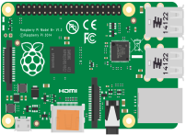
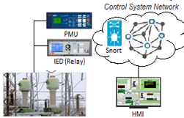
Flare Overview cont.
Alert
Flare
Flare can be deployed at:
Substation – A Dedicated server or SBC
Central Control Center – A Dedicated Server

Slide 10
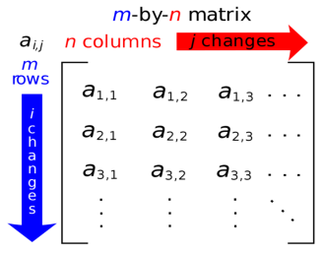
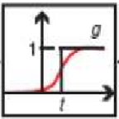

Flare Overview cont.
Phasor measurement unit
control room
Control Room SW Log
TRUE
FALSE
28 x Measurements
Current
Voltage
Magnitude
Impedance
Frequency
Alert
Relay
Relay Status
TRUE
FALSE
snort
Snort Log
TRUE
FALSE

Slide 11
Flare Overview cont.
Gaussian mixture model (GMM) and Correntropy
Promising results by GMM and Correntropy approaches reported in literature [1], [2], [3], [4] and [5]
Their use in the Electrical Power system event and intrusion detection domain is novel.
GMM allows us to aggregate a multivariate data sequences of power transmission control system into one variable to have numeric behavioral representation for decision making
Correntropy measure is operated on the posterior probabilities of the GMM to accurately establish the baseline for the normal system and detect anomalies.
Notes:
Waqas Haider, PHD research work “Developing Reliable Anomaly Detection System for Critical Hosts: A Proactive Defense Paradigm”, 2018, The University of New South Wales
A. Lagrange, M. Fauvel, and M. Grizonnet, “Large-scale feature selection with gaussian mixture models for the classification of high dimensional remote sensing images,” IEEE Transactions on Computational Imaging, vol. 3, no. 2, pp. 230–242, 2017.
L. P. Queiroz, F. C. M. Rodrigues, J. P. P. Gomes, F. T. Brito, I. C. Chaves, M. R. P. Paula, M. R. Salvador, and J. C. Machado, “A fault detection method for hard disk drives based on mixture of gaussians and nonparametric statistics,” IEEE Transactions on Industrial Informatics, vol. 13, no. 2, pp. 542–550, 2017.
J. P. Liu, O. F. Beyca, P. K. Rao, Z. J. Kong, and S. T. Bukkapatnam, “Dirichlet process gaussian mixture models for real-time monitoring and their application to chemical mechanical planarization,” IEEE Transactions on Automation Science and Engineering, vol. 14, no. 1, pp. 208–221, 2017.
K. B. Johnston and A. M. Peter, “Variable star signature classification using slotted symbolic markov modeling,” New Astronomy, vol. 50, pp. 1–11, 2017.

Slide 12
Introduction
Gaussian mixture model (GMM) and Correntropy
Malicious-stealthy-data patterns and legitimate event data dynamics are errors from decision making point of view
These errors create an element of bias in data sequences
Effect of this bias may be very large, it cannot be overlooked or treated as minor noise (non-gaussian or impulsive)
To process non-Gaussian and impulsive noises [waqas 51], the notion of Correntropy, which is a local measure of the similarity between any two random variables, is suggested in [waqs52]
Correntropy measure the precise behavioral boundaries for decision purposes.
Posterior probabilities (are utilized) of the data sequences obtained from GMM as input to the Correntropy as suggested in [1].
Because the interdependency of the power system’s data sequences can be more reliably estimated based on their prior and likelihood data distributions, i.e., posterior = prior x likelihood.
Notes:
Waqas Haider, PHD research work “Developing Reliable Anomaly Detection System for Critical Hosts: A Proactive Defense Paradigm”, 2018, The University of New South Wales
A. Lagrange, M. Fauvel, and M. Grizonnet, “Large-scale feature selection with gaussian mixture models for the classification of high dimensional remote sensing images,” IEEE Transactions on Computational Imaging, vol. 3, no. 2, pp. 230–242, 2017.
L. P. Queiroz, F. C. M. Rodrigues, J. P. P. Gomes, F. T. Brito, I. C. Chaves, M. R. P. Paula, M. R. Salvador, and J. C. Machado, “A fault detection method for hard disk drives based on mixture of gaussians and nonparametric statistics,” IEEE Transactions on Industrial Informatics, vol. 13, no. 2, pp. 542–550, 2017.
J. P. Liu, O. F. Beyca, P. K. Rao, Z. J. Kong, and S. T. Bukkapatnam, “Dirichlet process gaussian mixture models for real-time monitoring and their application to chemical mechanical planarization,” IEEE Transactions on Automation Science and Engineering, vol. 14, no. 1, pp. 208–221, 2017.
K. B. Johnston and A. M. Peter, “Variable star signature classification using slotted symbolic markov modeling,” New Astronomy, vol. 50, pp. 1–11, 2017.

Slide 13
Introduction
Why GMM and Correntropy (Corr-GMM) is used to model Detection engine
Power transmission control system data normal data is highly dynamic and multi dim (28)
Malicious-stealthy-data patterns and legitimate event data dynamics are errors from decision making point of view
These errors create an element of bias in data sequences
Effect of this bias may be very large, it cannot be overlooked or treated as minor noise (non-gaussian or impulsive)
To process non-Gaussian and impulsive noises [waqas 51], the notion of Correntropy, which is a local measure of the similarity between any two random variables, is suggested in [waqs52]
Notes:
Waqas Haider, PHD research work “Developing Reliable Anomaly Detection System for Critical Hosts: A Proactive Defense Paradigm”, 2018, The University of New South Wales
A. Lagrange, M. Fauvel, and M. Grizonnet, “Large-scale feature selection with gaussian mixture models for the classification of high dimensional remote sensing images,” IEEE Transactions on Computational Imaging, vol. 3, no. 2, pp. 230–242, 2017.
L. P. Queiroz, F. C. M. Rodrigues, J. P. P. Gomes, F. T. Brito, I. C. Chaves, M. R. P. Paula, M. R. Salvador, and J. C. Machado, “A fault detection method for hard disk drives based on mixture of gaussians and nonparametric statistics,” IEEE Transactions on Industrial Informatics, vol. 13, no. 2, pp. 542–550, 2017.
J. P. Liu, O. F. Beyca, P. K. Rao, Z. J. Kong, and S. T. Bukkapatnam, “Dirichlet process gaussian mixture models for real-time monitoring and their application to chemical mechanical planarization,” IEEE Transactions on Automation Science and Engineering, vol. 14, no. 1, pp. 208–221, 2017.
K. B. Johnston and A. M. Peter, “Variable star signature classification using slotted symbolic markov modeling,” New Astronomy, vol. 50, pp. 1–11, 2017.

Slide 14
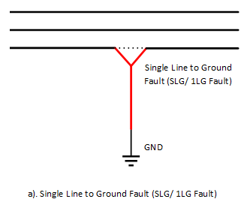
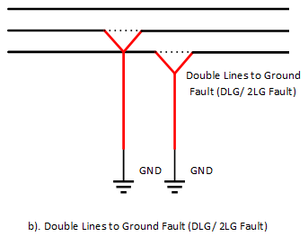
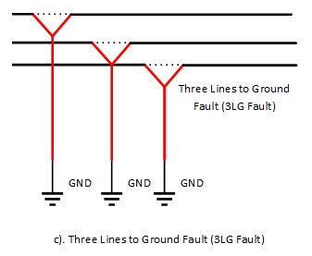
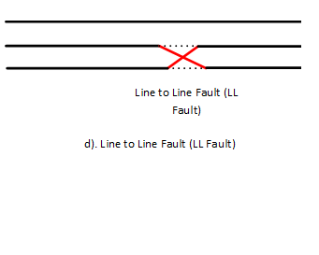
Power Line faults and contingencies
Power Line Faults
Notes:
Waqas Haider , “Developing Reliable Anomaly Detection System for Critical Hosts: A Proactive Defense Paradigm”, UNSW, 2018

Slide 15
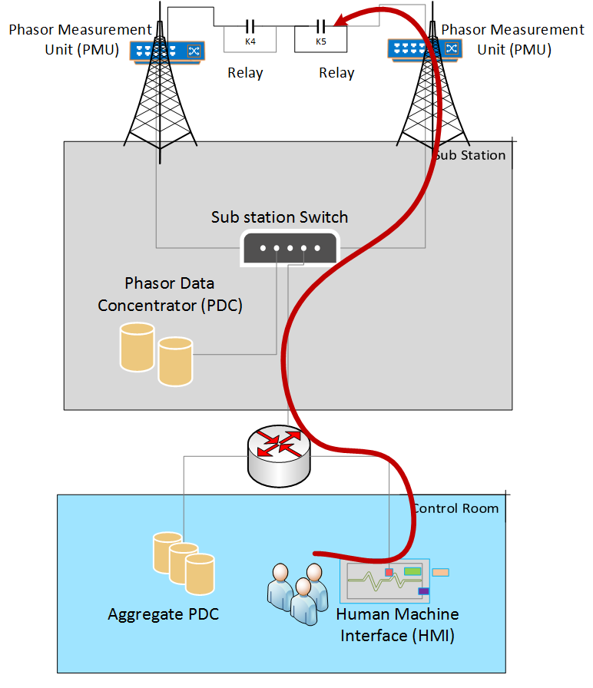
Power Line faults and contingencies
Line Maintenance
Notes:
Waqas Haider , “Developing Reliable Anomaly Detection System for Critical Hosts: A Proactive Defense Paradigm”, UNSW, 2018

Slide 16
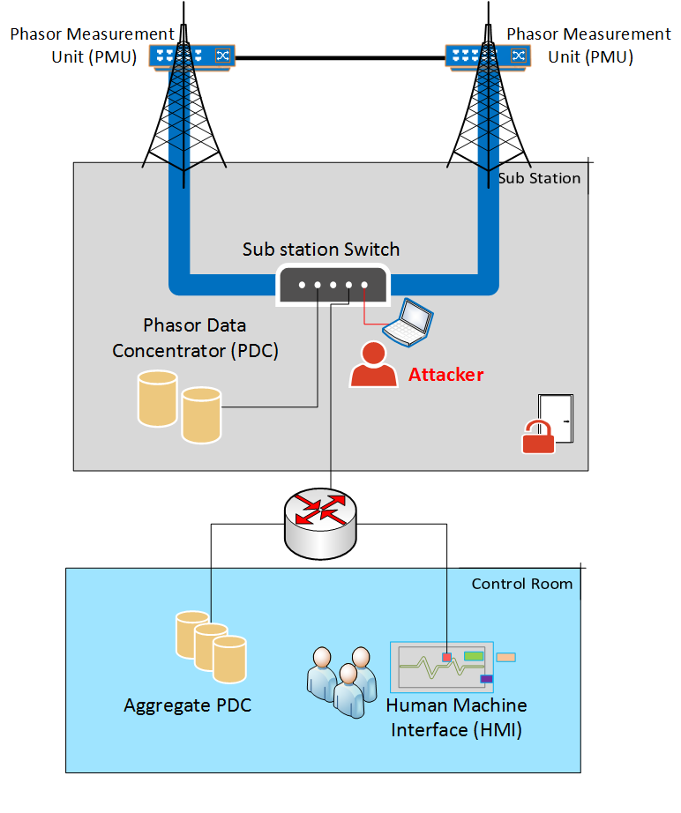
Cyber Attack on Power System
Data Injection Attack
Notes:
Waqas Haider , “Developing Reliable Anomaly Detection System for Critical Hosts: A Proactive Defense Paradigm”, UNSW, 2018

Slide 17
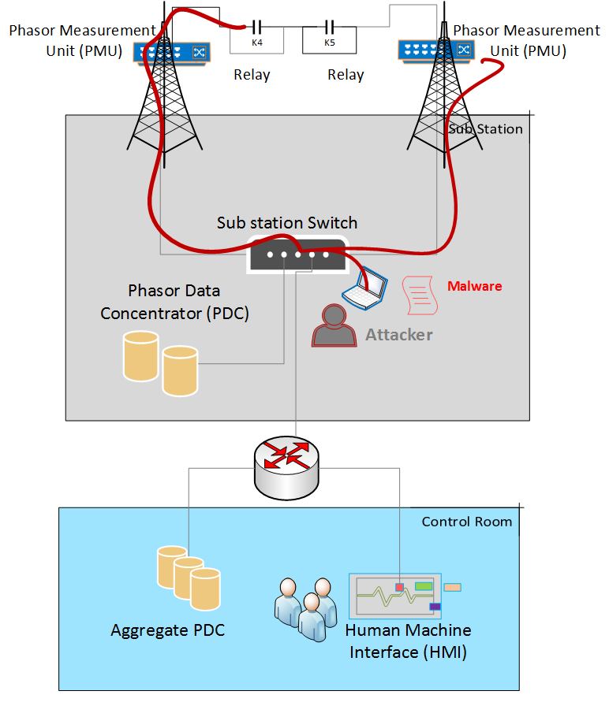
Cyber Attack on Power System
Command Attack
Notes:
Waqas Haider , “Developing Reliable Anomaly Detection System for Critical Hosts: A Proactive Defense Paradigm”, UNSW, 2018

Slide 18
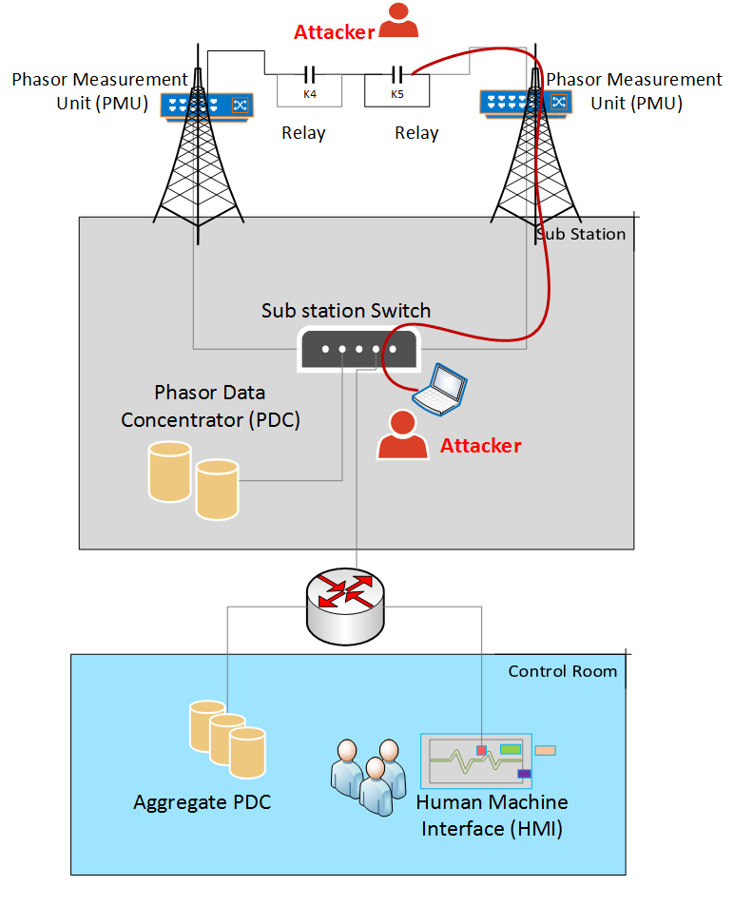
Cyber Attack on Power System
Relay Setting Attack
Notes:
Waqas Haider , “Developing Reliable Anomaly Detection System for Critical Hosts: A Proactive Defense Paradigm”, UNSW, 2018

Slide 19

Flare system design
1
2
4
Event Parsor
And
Processer
Gaussain Probability
density
estimation
CorrEntroy
Detector Threshold
1
4
2
3
CorrEntroy
Synchrophasor measurements
Data Logs from,
Snort
Control panel
Relays
3

Slide 20
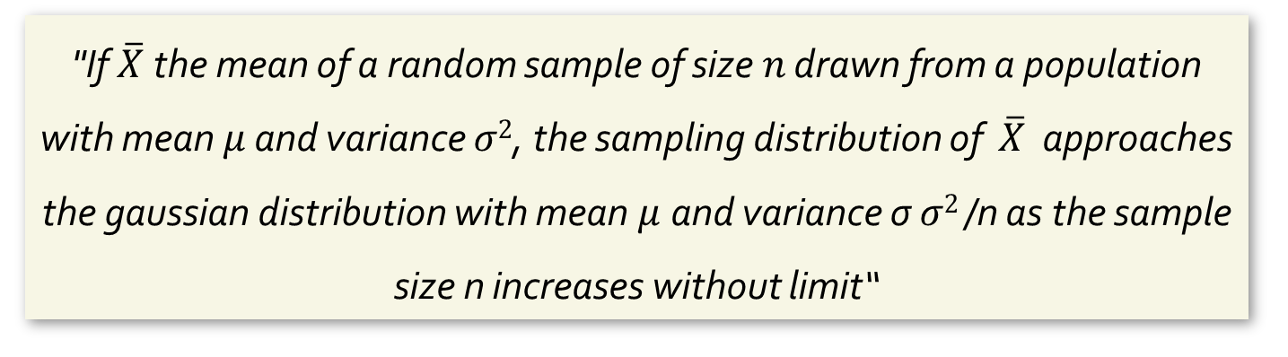
Central Limit Theorem
"If $\overline{X}$ the mean of a random sample of size$n$ drawn from a population with mean $μ$ and variance $σ2$, the sampling distribution of $\overline{X}$ approaches the gaussian distribution with mean $μ$and variance σ $σ2$/n as the sample size n increases without limit“
Histograms of sampling means of power system WAMS’s quantities, voltage and current synchrophasors tends to be normally distributed / gaussian.

Slide 21
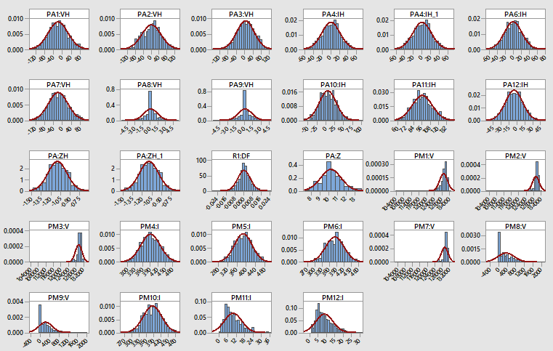
Central Limit Theorem
*Plots created in Minitab V18

Slide 22
Flare system design
How and why GMM and Correntropy (Corr-GMM) is used
Malicious-stealthy-data patterns and legitimate event data dynamics can be viewed as errors in statistics
These errors can play a vital role from decision engine point of view
Errors create an element of bias in data sequences
Effect of this bias cannot be overlooked or treated as minor noise (non-gaussian or impulsive)
To process non-Gaussian and impulsive noises the notion of Correntropy, which is a local measure of the similarity between any two random variables, is suggested in [Haider, PHD Thesis]
Notes:
Waqas Haider , “Developing Reliable Anomaly Detection System for Critical Hosts: A Proactive Defense Paradigm”, UNSW, 2018

Slide 23
Flare system design cont.
How and why GMM and Correntropy (Corr-GMM) is used
Correntropy measure is used to create the precise behavioral boundaries for classification purposes.
We utilized the posterior probabilities of the data sequences obtained from GMM as input to the Correntropy as suggested in [Haider, PHD Thesis] Because the interdependency of the power system’s data sequences can be more reliably estimated based on their prior and likelihood data distributions, i.e., posterior = prior x likelihood.
Notes:
Waqas Haider , “Developing Reliable Anomaly Detection System for Critical Hosts: A Proactive Defense Paradigm”, UNSW, 2018

Slide 24








Flare Framework cont.
important notations to proceed in-depth understanding of Flare working mechanism
Alert
$$A=πr^{2}$$
Symbol | Description
 | A multi-dimensional random variable, $X=\{x1,x2,x3…xm\}$; where m is the number of features
$$xj$$ | Feature variable; $j=\{1,…m\}$
 | Mean of observations of j_{th} feature
 | Standard Deviation of observations of j_{th} feature
 | Probabilistic proportions/ weight of each feature
$π$ and $𝓮$ | 3.14159 and 2.71828
 | Gaussian/ Normal Distribution
$$X$$
$$μ_{j}$$
$$θ$$
$$σ_{j}$$
$$ωk$$
$$𝒩(x|μ,σ2)$$

Slide 25

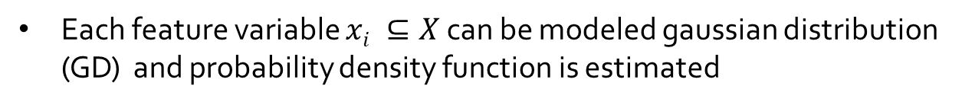
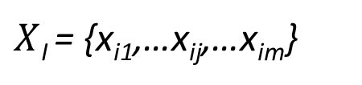
FLARE FRAMEWORK cont.
Each feature variable (i.e. PMU’s quantities) comprise n measurements, where the i_{th} reading from the m-dimensional
X variable space is expressed as,
$X$_{I} = {x_{i1},…x_{ij},…x_{im}}
Each feature variable $xi ⊆X$ can be modeled gaussian distribution (GD) and probability density function is estimated
Eq 1
π = 3.14159
e = 2.71828

Slide 26


FLARE FRAMEWORK cont.
The posterior probability of taking the i_{th} measurement value (X_{i})
formulated by,
Eq 2
The posterior probabilities of all the whole measurements can be
estimated by,
Eq 3

Slide 27




FLARE FRAMEWORK cont.
The Correntropy of the two consecutive observations,
The Correntropy of the two consecutive observations,
$A=p\left(Xi | θ\right) and p(Xi+1$| $θ$)
Correntropy-induced metric (CIM) employed by (Haider, 2018) to measure the local similarity between to measurements, for any two observations (A and B) is as:
Eq 4
Upper and Lower correntropy values are used to accurately specify a normal proﬁle,
Eq 5
Eq 6

Slide 28
FLARE FRAMEWORK cont.
Flare during Learning
Input
i for sequences and k for features) | k=1 | k=2 | k=3 | k=4 | Label
i=1 | 1 | 2 | 3 | 4 | Normal
i=2 | 2 | 3 | 4 | 5 | Normal
i=3 | 3 | 4 | 5 | 6 | Normal
i=4 | 4 | 5 | 6 | 7 | Normal
i=5 | 5 | 6 | 7 | 8 | Normal
i=6 | 6 | 7 | 8 | 9 | Normal
Parameters Estimation
Mean (µ) | 3.5 | 4.5 | 5.5 | 6.5
Standard deviation (σ) | 1.870828693 | 1.870828693 | 1.870828693 | 1.8708286
Variance ( ) | 3.5 | 3.5 | 3.5 | 3.5
Weight (𝜔) | 0.25 | 0.25 | 0.25 | 0.25
$$σ^{2}$$

Slide 29
FLARE FRAMEWORK cont.
Flare during Learning
Probability Density Function (PDF) estimation
using Eq 1
0.087319877 | 0.087319877 | 0.087319877 | 0.087319877
0.154625597 | 0.154625597 | 0.154625597 | 0.154625597
0.205762168 | 0.205762168 | 0.205762168 | 0.205762168
0.205762168 | 0.205762168 | 0.205762168 | 0.205762168
0.154625597 | 0.154625597 | 0.154625597 | 0.154625597
0.058951848 | 0.120422536 | 0.18485618 | 0.213243619
PDF with weights
using Eq 2
Posterior
using Eq 3
0.021829969 | 0.021829969 | 0.021829969 | 0.021829969
0.038656399 | 0.038656399 | 0.038656399 | 0.038656399
0.051440542 | 0.051440542 | 0.051440542 | 0.051440542
0.051440542 | 0.051440542 | 0.051440542 | 0.051440542
0.038656399 | 0.038656399 | 0.038656399 | 0.038656399
0.014737962 | 0.030105634 | 0.046214045 | 0.053310905
0.087319877
0.154625597
0.205762168
0.205762168
0.154625597
0.144368546
$$σ^{2}$$

Slide 30
FLARE FRAMEWORK CONT
Flare during Learning
Calculate correntropies
using Eq 4
1.000007444
1.000008769
1.000008944
1.000007444
1.000005945
1.000007195
Calculate the upper correntropy and lower correntropy using
equation 5 and 6.
Lower corr normal | 1.000005945
Upper corr normal | 1.000008944
$$σ^{2}$$

Slide 31

FLARE FRAMEWORK cont.
Flare during Execution
Estimate the PDFs using the parameters of normal profile and
Calculate the correntropies using equations mentioned before.
Compare the correntropies against the decision correntropies
using,
$$σ^{2}$$

Slide 32
RATIONALE OF UTILZED MATH MODEL
Why GMM and Correntropy (Corr-GMM) is used to model Detection engine
Data collection and transmission over power system are subjected to contaminate with destructive-stealthy-data pattern
While logging Power system then logged data is multi model data/ multi dim (28)
Power system’s normal data is highly dynamic due to number and purposes of stakeholders (i.e., consumers and managers).
Malicious-stealthy-data patterns and legitimate event data dynamics are errors from decision making point of view
These errors create an element of bias in data sequences
Effect of this bias may be very large, it cannot be overlooked or treated as minor noise (non-gaussian or impulsive)
To process non-Gaussian and impulsive noises [waqas 51], the notion of Correntropy, which is a local measure of the similarity between any two random variables, is suggested in [waqs52]
The data patterns become stealthy due to: a) attacker’s monitoring of system behaviour and mixing malicious payload to camouflage abnormal behaviour b) high similarity between natural and malicious-intentional physical faults; and c) high similarity between legitimate and illegal command and control artefacts.

Slide 33
RATIONALE OF UTILZED MATH MODEL
Why GMM and Correntropy (Corr-GMM) is used to model Detection engine Cont.
Correntropy measure the precise behavioral boundaries for classification purposes.
Utilized the posterior probabilities of the data sequences obtained from GMM as input to the Correntropy as suggested in [1]. Because the interdependency of the power system’s data sequences can be more reliably estimated based on their prior and likelihood data distributions, i.e., posterior = prior x likelihood.
GMM also allows to aggregate a multivariate data sequence of power sys into one variable to have numeric behavioral representation for decision making
GMM and Correntropy approaches have been successfully implemented in a number of applications, including recognition [15], [16], [17], [18], their use in the Power system EIDS domain is novel.

Slide 34


results
Flare Performance Evaluation
To evaluate the performance of Flare, we performed benchmarks,
On a Raspberry Pi 3 Model B, 1.2 GHz and 1GB RAM (Substation Depl)
A Windows 10 running on an Intel Core i7 CPU 870, 2.93 GHz with 8GM (Central Depl)
Complete implementation is done in Python.
The DR, FAR represents the accurac and error of Flare, respectively. The
FAR is the average of two errors, the False Positive Rate (FPR) and False
Negative Rate (FNR).
FAR can well indicate the capacity of Flare to incorrectly detect normal behavior as abnormal and abnormal behavior as normal, respectively (Haider, 2018).
Notes:
Uttam Adhikari, “Event and intrusion detection systems for cyber-physical power systems”, Ph.D. dissertation, Mississippi State University, August 2015.
Pan, Shengyi, Thomas H. Morris, and Uttam Adhikari. "A Specification-based Intrusion Detection Framework for Cyber-physical Environment in Electric Power System." IJ Network Security 17, no. 2(2015): 174-188.

Slide 35
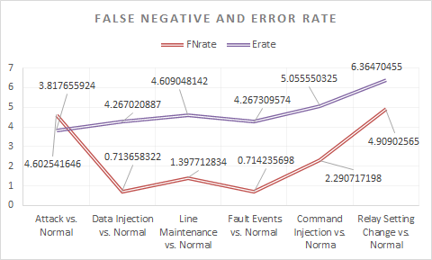
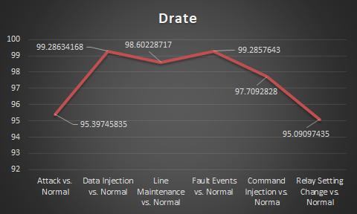
results – Central Deployment
Scenario | FPrate | FNrate | Error Rate | DRate
Attack vs. Normal | 3.0328 | 4.603 | 3.818 | 95.39745835
Data Injection vs. Normal | 7.8204 | 0.714 | 4.267 | 99.28634168
Line Maintenance vs. Normal | 7.8204 | 1.398 | 4.609 | 98.60228717
Fault Events vs. Normal | 7.8204 | 0.714 | 4.267 | 99.2857643
Command Injection vs. Norma | 7.8204 | 2.291 | 5.056 | 97.7092828
Relay Setting Change vs. Normal | 7.8204 | 4.909 | 6.365 | 95.09097435
Notes:
Uttam Adhikari, “Event and intrusion detection systems for cyber-physical power systems”, Ph.D. dissertation, Mississippi State University, August 2015.
Pan, Shengyi, Thomas H. Morris, and Uttam Adhikari. "A Specification-based Intrusion Detection Framework for Cyber-physical Environment in Electric Power System." IJ Network Security 17, no. 2(2015): 174-188.

Slide 36
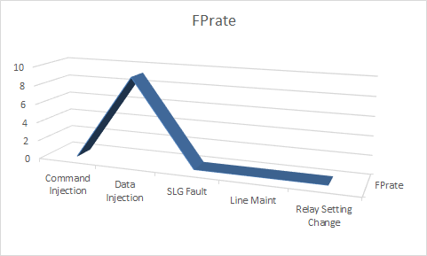
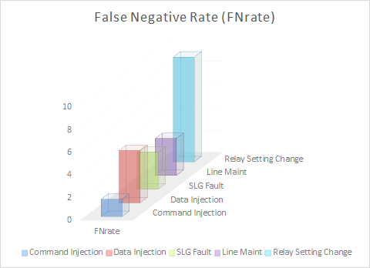
results – Substation - IED Deployment
Scenario | FPrate | Fnrate | Errorrate | Drate
Command Injection | 0 | 1.513877208 | 0.75694 | 98.486
Data Injection | 9.2 | 4.6 | 0.75694 | 90.79
SLG Fault | 0 | 3.25 | 1.62 | 96.74
Line Maint | 0 | 3.25 | 1.62 | 96.74
Relay Setting Change | 0 | 9.2 | 4.6 | 90.72
Notes:
Uttam Adhikari, “Event and intrusion detection systems for cyber-physical power systems”, Ph.D. dissertation, Mississippi State University, August 2015.
Pan, Shengyi, Thomas H. Morris, and Uttam Adhikari. "A Specification-based Intrusion Detection Framework for Cyber-physical Environment in Electric Power System." IJ Network Security 17, no. 2(2015): 174-188.

Slide 37
results – datasets for Cen Depl
Event Name | Description | # of measurements | Train [sec] | Execute [sec]
Short-circuit fault | This is a short in a power line and can occur in various locations along the line. | Train = 2423 Execute = 16982 | 21 | 93
Line Maintenance | Relays is disabled on a specific line to do maintenance for that line | Train = 2423 Execute = 5291 | 22 | 46
Attacks Name | Description | # of measurements | Train [sec] | Execute [sec]
Data Injection | Imitation of a valid fault by changing values to parameters such as current, voltage, sequence components etc. This attack aims to blind the operator and causes a black out. | Train = 2423 Execute = 11564 | 22 | 100
Command injection - Remote trip relay | Attacker sends a command to a relay which causes a breaker to open. It can only be done once an attacker has penetrated outside defenses | Train = 2423 Execute = 10719 | 21 | 93
Notes:
Uttam Adhikari, “Event and intrusion detection systems for cyber-physical power systems”, Ph.D. dissertation, Mississippi State University, August 2015.
Pan, Shengyi, Thomas H. Morris, and Uttam Adhikari. "A Specification-based Intrusion Detection Framework for Cyber-physical Environment in Electric Power System." IJ Network Security 17, no. 2(2015): 174-188.

Slide 38
results – datasets for Cen Depl
Scenario | Description | # of measurements | Train [sec] | Execute [sec]
Command injection - Relay setting change | Relays are configured with a distance protection scheme and the attacker changes the setting to disable the relay function such that relay will not trip for a valid fault or a valid command. | Train = 2423 Execute = 39326 | 21 | 364
Anomaly | The training dataset is composed o f the measurements from normal, natural faults and line maintenance and test dataset composed of | Train = 12490 Execute = 65889 | 115 | 639
Notes:
Uttam Adhikari, “Event and intrusion detection systems for cyber-physical power systems”, Ph.D. dissertation, Mississippi State University, August 2015.
Pan, Shengyi, Thomas H. Morris, and Uttam Adhikari. "A Specification-based Intrusion Detection Framework for Cyber-physical Environment in Electric Power System." IJ Network Security 17, no. 2(2015): 174-188.

Slide 39
results – datasets for Substation Depl
Scenario | # of measurements | Train [sec] | Execute [sec]
Short-circuit fault | Nomral Training Instance = 3524 Normal Test Instance = 879 Attack Test Instance = 14243 | 43 | 137
Line Maintenance | Nomral Training Instance = 3524 Normal Test Instance = 879 Attack Test Instance = 3041 | 43 | 127
Data Injection | Nomral Training Instance = 3524 Normal Test Instance = 879 Attack Test Instance = 9582 | 43 | 192
Command injection - Remote trip relay | Nomral Training Instance = 3524 Normal Test Instance = 879 Attack Test Instance = 8739 | 43 | 44
Command injection - Relay setting change | Nomral Training Instance = 3524 Normal Test Instance = 879 Attack Test Instance = 36159 | 43 | 142
Notes:
Uttam Adhikari, “Event and intrusion detection systems for cyber-physical power systems”, Ph.D. dissertation, Mississippi State University, August 2015.
Pan, Shengyi, Thomas H. Morris, and Uttam Adhikari. "A Specification-based Intrusion Detection Framework for Cyber-physical Environment in Electric Power System." IJ Network Security 17, no. 2(2015): 174-188.

Slide 40
Comparison
Algorithm(s) | Result
Naïve Bayes,OneR, NNge, Jripper,Random Forests,SVM,Adaboost | JRipper+Adaboost having the highest overall F-Measure 0.955
Novel Specification-based Bayesian network | 100% for Nine scenarios
Sequential Pattern Mining algorithm | 95 % for Experiment 1 87.6% fro Experiment 2 93.21 % for Experiment 3
Temporal state-based specifications Learning | 90.4 % accuracy 73.43 % For Zero-days
Fuzzy c-means (FCM) algorithm combined with the fuzzy inference system (FIS) | 99.11 % Overall accuracy
Hoeffding Adaptive Trees (HAT) augmented with the drift detection method (DDM) and adaptive windowing (ADWIN) | The average kappa statistic was 94% for binary and 93% for multiclass classification.
Notes:
Uttam Adhikari, “Event and intrusion detection systems for cyber-physical power systems”, Ph.D. dissertation, Mississippi State University, August 2015.
Pan, Shengyi, Thomas H. Morris, and Uttam Adhikari. "A Specification-based Intrusion Detection Framework for Cyber-physical Environment in Electric Power System." IJ Network Security 17, no. 2(2015): 174-188.

Slide 41
Comparison
Algorithm(s) | Result
Specification-Based and Decision trees, instance-based learning and NNGE | NNGE+STEM algorithm provides 96% and 93% detection accuracy for Binary and Multi Class datasets HAT algorithm provides 98% and 92% for Binary and Multi Class datasets respectively
Non mested generalized Exampler (NNGE) with State Extraction Method (STEM) | 94.0% with NNGE for Multiclass Classification 98% with NNGE for Binary Class Classification 99.54% with NNGE for Multi Class Classification on the IEEE 9 Bus System
Extreme Learning Machine (ELM) model optimized by the Adaptive Elitist Differential Evolution algorithm (AEDE) | 96.55% with proposed AEDE-ELM
Notes:
Uttam Adhikari, “Event and intrusion detection systems for cyber-physical power systems”, Ph.D. dissertation, Mississippi State University, August 2015.
Pan, Shengyi, Thomas H. Morris, and Uttam Adhikari. "A Specification-based Intrusion Detection Framework for Cyber-physical Environment in Electric Power System." IJ Network Security 17, no. 2(2015): 174-188.

Slide 42
Comparison
Algorithm(s) | Result
Stacked Sutoencoders | 99.89 % for Normal Events 98.94 % for Data Injection Attacks 97.34% for Command Injection Attack 98.53 % for Relay Setting Change Attack
Probabilistic classification (Bayesnet), Rule induction (OneR, Ripper), Decision tree learning (C4.5), Non-probabilistic binary classification (SVM), The Ensemble Methods (Adaptive boosting, Bagging, Majority voting, Random forest) | Bagging C4.5, Adaboost Ripper, Adaboost C4.5 and Random forest achieved more than 90 % accuracy
NNGE HAT Common Path Mining | 94 % with NNGE 94% with HAT 93% with Common Path Minng Algoithm
Notes:
Uttam Adhikari, “Event and intrusion detection systems for cyber-physical power systems”, Ph.D. dissertation, Mississippi State University, August 2015.
Pan, Shengyi, Thomas H. Morris, and Uttam Adhikari. "A Specification-based Intrusion Detection Framework for Cyber-physical Environment in Electric Power System." IJ Network Security 17, no. 2(2015): 174-188.

Slide 43
Thank You

